Slide 1
Swiss Cyber Storm 2016 – Turbo Talk Client TLS Testing Detecting Obfuscated JavaScripts
Prof. Dr. Marc Rennhard
Head of Information Security Research Group
Institute of Applied Information Technology (InIT)
ZHAW School of Engineering
rema@zhaw.ch

Slide 2
About the Information Security Research Group
Part of InIT at ZHAW
InIT: Institute of Applied Information Technology
ZHAW: Zurich University of Applied Sciences
3 professors/lecturers, 8-10 researchers
Main activity: Applied research projects with industrial / academic partners
≈20 large R&D projects during the past 10 years (mostly CTI and EU)
One key research area: Automated security analysis and security testing

Slide 3
Client TLS Testing
Motivation
TLS is the most widely used secure communication protocol
Several services and tools to test the security of TLS servers
Only few tools to test the security of client-side TLS implementations and configurations
Goal: Develop a powerful tool for client TLS testing
Current focus on testing the processing of server certificates
Very security-critical component as wrong handling of certificates may allow e.g. MITM attacks
1
2
Use any TLS client application to be tested
Testing tool runs as TLS server application
Notes:
Basic functionality
Testing tool runs as a TLS server application
The client is used to repeatedly initiate TLS sessions with the tool
The tool uses each TLS session to perform a different certificate test case
Analyzing the behavior of the client, the tool rates a test as passed / failed

Slide 4
Client TLS Testing – Tool Usage in Practice
Now the client application to test can initiate repeatedly TLS sessions with the testing tool and during each TLS session, a certificate test case is carried out:
Passed means the behavior is according to the RFC / no security problem
Failed means not compliant with the RFC / potential security problem
+120 certificate tests integrated, covering various aspects of certificates and certificate chains
Notes:
Two modes of operation
Interactive mode: User has to reinitiate TLS sessions manually
Automated mode: Client automatically initiates multiple TLS sessions

Slide 5
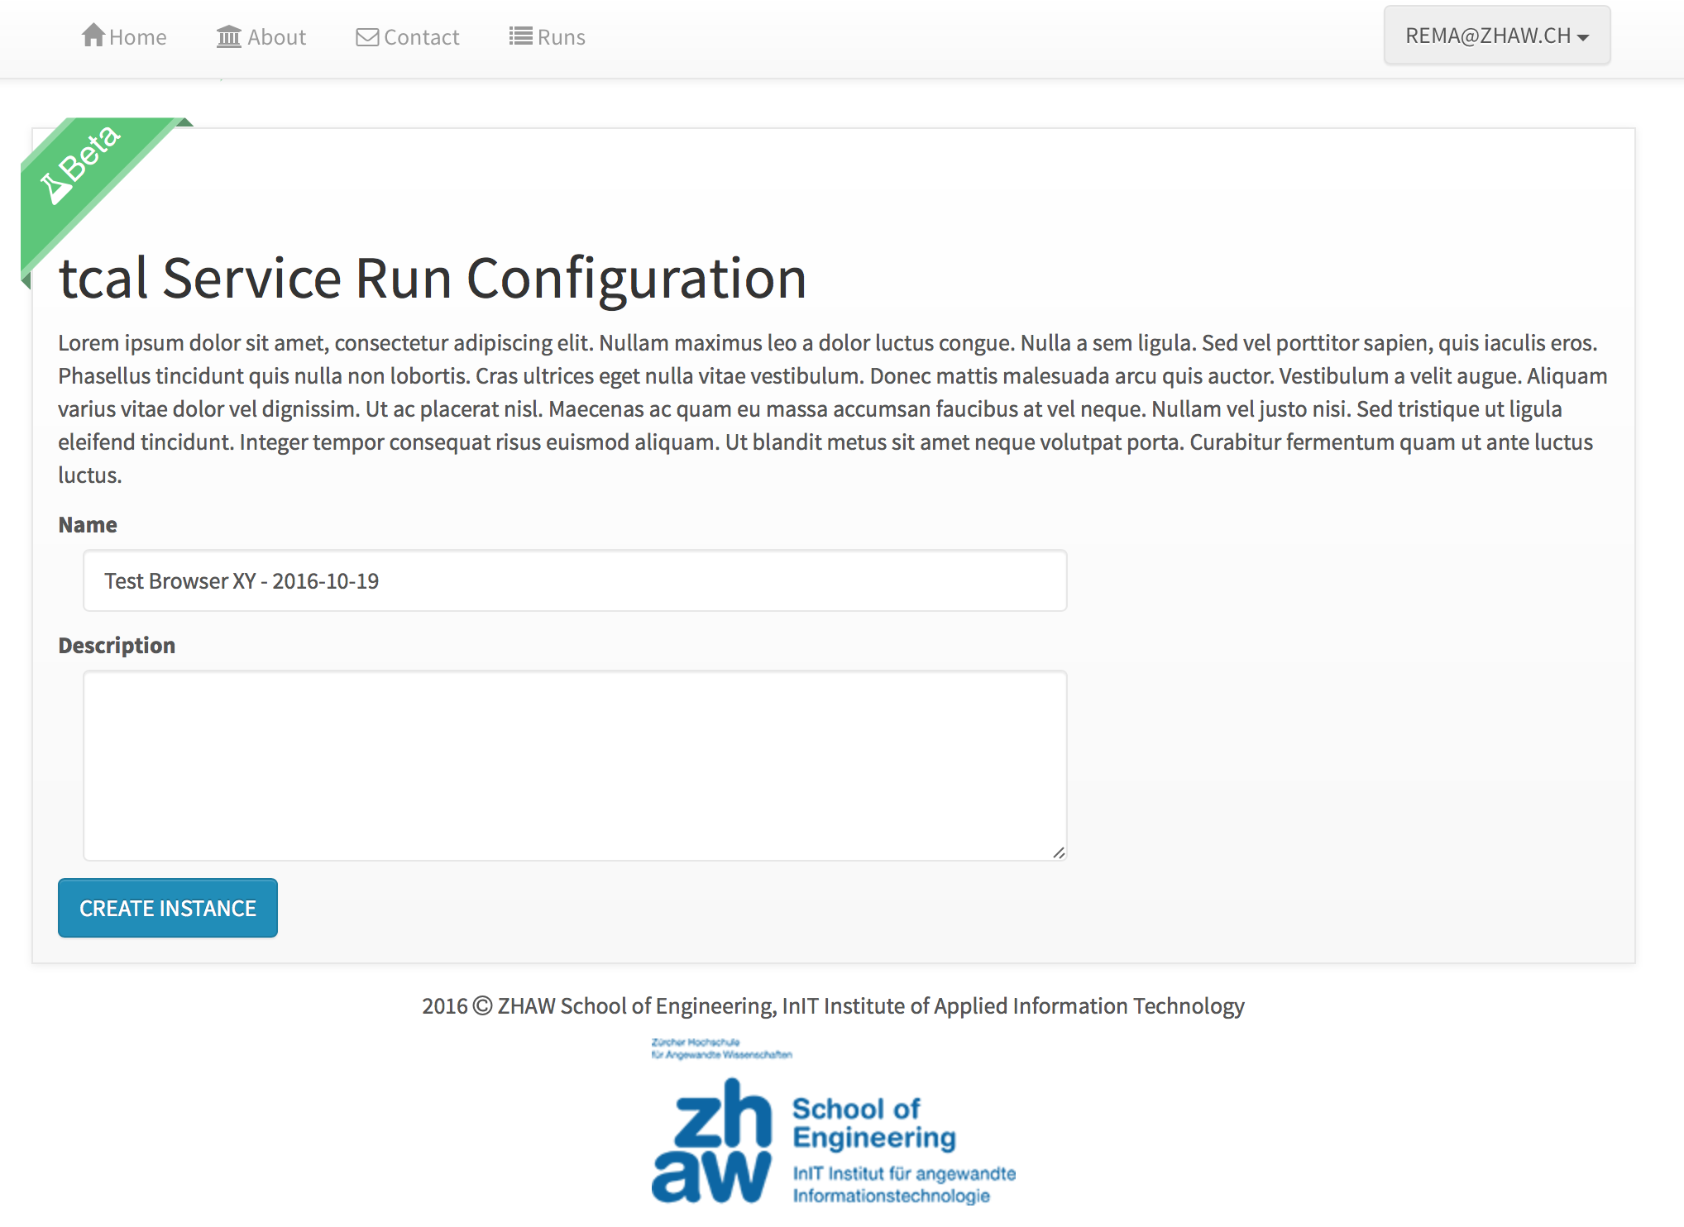
Client TLS Testing – Web-based Service
Notes:
You just have to click a button, which creates a testing tool instance just for you.
You can then use this instance to test any client application you want.

Slide 6
Client TLS Testing – Status and Outlook
Current status and next steps
Tool works well to efficiently test client-side TLS implementations
Systematically test all widespread browsers and TLS libraries with the goal to find security problems
Future plans
Public release of the testing tool
Provide Web-based service / release tool as open source software
Extend with further tests, e.g. TLS protocol fuzzing
Thanks to all people involved!
Stefan Berhardsgrütter, Lucas Graf, Damiano Esposito (InIT)
Tobias Ospelt (modzero)
Notes:
First results are «interesting», but more analysis required

Slide 7
Detecting Obfuscated JavaScripts
Motivation
JavaScript is often used as an attack vector to deliver malware
XSS vulnerabilities, Web-based malware distribution (drive-by),...
Detection using signature-based approaches are not ideal, easy to circumvent e.g. by obfuscating JavaScripts
Most malicious JavaScripts are obfuscated
Benign JavaScripts are usually not obfuscated
If obfuscated JavaScripts can be reliably detected, this serves as a good first indicator whether a script is malicious / benign
Goal of the project: Find a method to classify JavaScripts as obfuscated / non-obfuscated with high accuracy
Based on a machine learning approach

Slide 8
Detecting Obfuscated JavaScripts – Data Set
Having a large, representative data set with correctly labelled samples is key to machine learning
Out data set consists of +100'000 JavaScripts
From different sources: top global websites, JavaScript libraries, MELANI (malicious samples)
Includes samples from more than 10 different obfuscators
The data set was used to train different binary classifier
The trained classifier takes any JavaScript as input and classifies it as obfuscated / non-obfuscated

Slide 9
Detecting Obfuscated JavaScripts – Classification Performance
Boosted Decision Tree performed best to solve the problem
Two important values to assess the performance of trained machine learning models are precision and recall
With BDT, we could achieve values of 99% or better
Less than 1 out of 100 JavaScripts is classified incorrectly

Slide 10
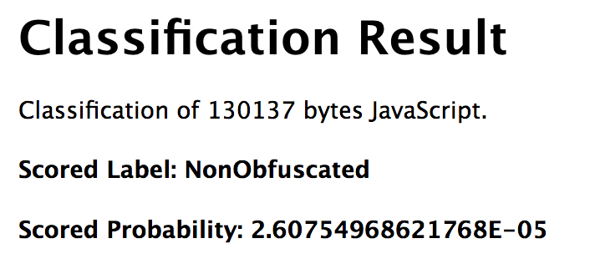
Detecting Obfuscated JavaScripts – Conclusions and Outlook
Key Findings
Machine learning works well to classify obfuscated / non-obfuscated JavaScripts
Machine Learning is no magic solution: correctly classifying a script that uses an obfuscator not present in the training set is much more difficult
Try it out: http://jsclassify.azurewebsites.net/
Future work
Our classifier serves as a good indicator for malicious / benign JavaScripts, but the ultimate goal is to have a classifier that outputs malicious / benign
Main obstacle: Number of malicious samples in the data set is currently not representative enough (only about 2'700 samples)
Publications
S. Aebersold, K. Kryszczuk, S. Paganoni, B. Tellenbach, T. Trowbridge. Detecting Obfuscated JavaScripts Using Machine Learning. ICIMP 2016
B. Tellenbach, S. Paganoni, M. Rennhard. Detecting Obfuscated JavaScripts from Known and Unknown Obfuscators using Machine Learning (under review)
Notes:
It depends on how well the used obfuscator is represented by the obfuscators in the training set.

